Slide 1

7th Grade Math
Unit 7, Lesson 6 Determining Tax, Tip, or Fees Given a Percentage Volume 1, pg. 319

Slide 2


Benchmark
MA.7.AR.3.1
Apply previous understanding of percentages and ratios to solve multi-step, real-world percent problems.
volume 1, pg. 319

Slide 3
Integrated Mathematical Thinking and Reasoning Standards
MA.K12.MTR.3.1 Complete tasks with mathematical fluency.
MA.K12.MTR.6.1 Assess the reasonableness of solutions.
MA.K12.MTR.7.1 Apply mathematics to real-world contexts.
volume 1, pg. 319

Slide 4

Learning Targets
I can determine the amount of tax, tip, or fee given a percentage.
I can determine the percentage of a discount or markup.
volume 1, pg. 319

Slide 5

Warm-Up
volume 1, pg. 319

Slide 6
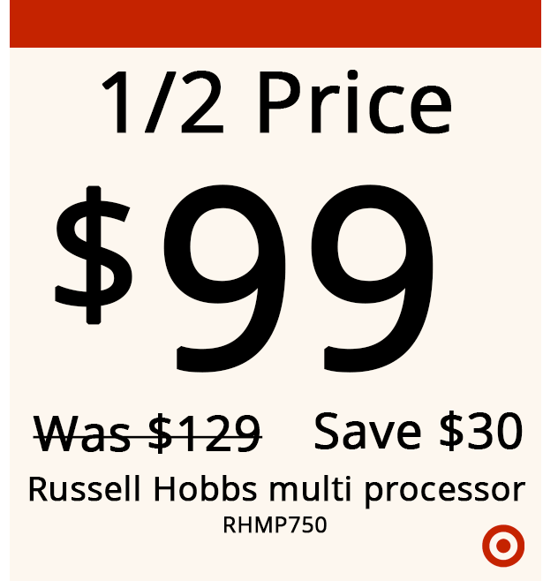
7.6.1 Warm-Up: Math Fail
The following sticker was placed on an item for sale.
Describe any error(s) on the sticker.
Correct the sticker so that it accurately reflects the “1/2 Price” advertised in the first line.
volume 1, pg. 319

Slide 7

Guided Instruction
volume 1, pg. 320

Slide 8

7.6.2 Guided Instruction: Finding the Percentage of a Discount or Markup
Recall that discount and markup problems typically include given percentages.
The tape diagram shows the original cost of a shirt, $30.
A store manager wants to sell more of this shirt before the end of summer. The manager decides to put the shirt on sale for 1/3 off the original price.
Will customers pay more or less than the original price for the shirt?
volume 1, pg. 320

Slide 9


The tape diagram is divided into thirds.
What is the price of the shirt after the discount?
How much will customers save from the original price?
Discuss with your partner how to calculate the percentage discounted if given the original price of the shirt and the sale price of the shirt.
If the $30 shirt was discounted to $18, what percentage of the shirt was discounted?
discount
volume 1, pg. 320

Slide 10
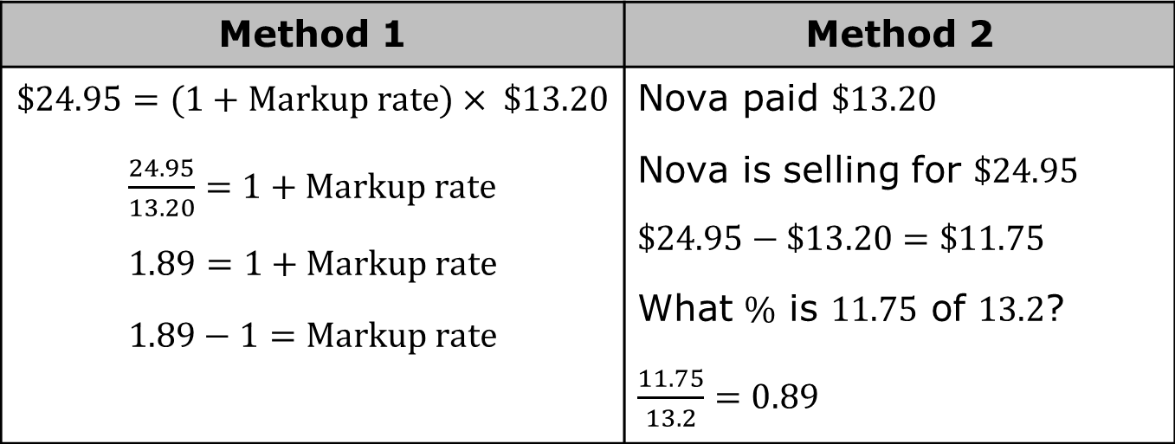
Nova buys earrings from a supplier for $13.20. She sells them in her boutique for $24.95. Clare works at the boutique and was curious what percentage markup Nova uses. The table shows 2 different methods Clare used to determine the percentage the earrings are marked up when sold.
Method 1 | Method 2
$$\$24.95=(1+Markup rate)× \$13.20$$ $\frac{24.95}{13.20}=1+Markup rate$ $1.89=1+Markup rate$ $1.89−1=Markup rate$ | Nova paid $13.20 Nova is selling for $24.95 $$\$24.95−\$13.20=\$11.75$$ What % is 11.75 of 13.2? $\frac{11.75}{13.2}=0.89$
volume 1, pg. 321

Slide 11
Compare both methods. Discuss the similarities and differences in the two methods with your partner. Then, write them in the table.
What is the percentage of the markup?
Similarities | Differences
volume 1, pg. 321

Slide 12

Try It
volume 1, pg. 321

Slide 13

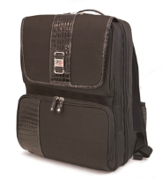
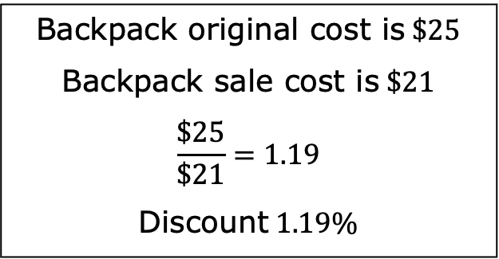
7.6.3 Try It: Finding the Percentage of a Discount or Markup
Johnetta calculated the percentage discounted for a backpack that normally costs $25 but is on sale for $21. Johnetta has made errors in her work. Identify Johnetta’s errors and correct her work.
volume 1, pg. 321

Slide 14
Guided Instruction
volume 1, pg. 322

Slide 15
7.6.4 Guided Instruction: Taxes, Tips, and Fees
Baxter has been saving all of his money to purchase new Nike Air Max sneakers. After four months, he finally had $200 saved, so he went to purchase the sneakers. Unfortunately, when Baxter checked out, the total came to $212, which was $12 more than he had saved.
Discuss with your partner why Baxter’s total was more than $200.
Subtotal | $200.00
Estimated Shipping | $0.00
Estimated Tax | $12.00
TOTAL | $212.00
volume 1, pg. 322

Slide 16
If Baxter had to pay 8% sales tax on the same Nike Air Max sneakers, what would the cost of the taxes be?
Explain whether the estimated tax from Baxter’s online search was more or less than 8%.
volume 1, pg. 322

Slide 17
Work with your partner to complete the following.
The Cardone Family is planning to have a birthday celebration at one of their favorite restaurants. The restaurants they are considering are in different counties that each have different sales tax rates.
Complete the table to determine how much tax will be at each restaurant given the same pre-tax cost of dinner. The first row of the table has been completed.
volume 1, pg. 322

Slide 18
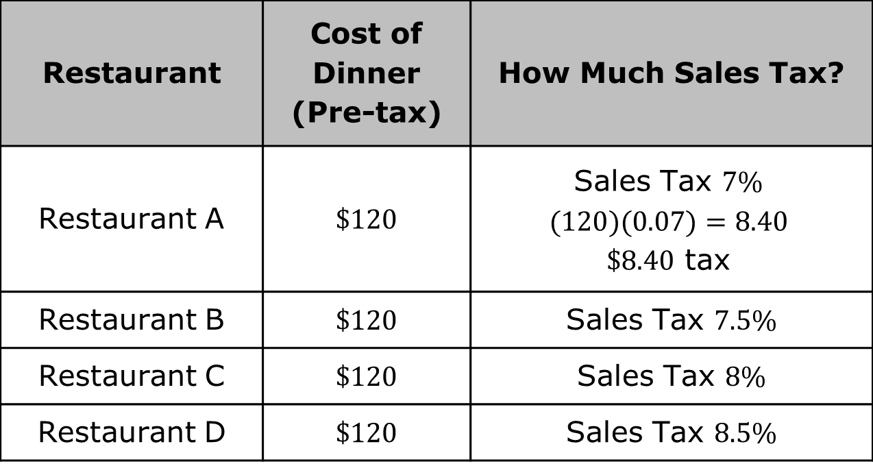
Restaurant | Cost of Dinner (Pre-tax) | How Much Sales Tax?
Restaurant A | $120 | Sales Tax 7% $$(120)(0.07)=8.40$$ $8.40 tax
Restaurant B | $120 | Sales Tax 7.5%
Restaurant C | $120 | Sales Tax 8%
Restaurant D | $120 | Sales Tax 8.5%
volume 1, pg. 322

Slide 19
The Cardone Family plans to leave a tip for their server. They intend to tip 20% of the cost of their dinner. If the cost of dinner is $120, how much tip will the server receive?
Qualyen bought a new computer and printer online totaling $850. He had to pay an additional 3% in shipping fees on top of the $850. With your partner, determine the cost of the shipping fees.
volume 1, pg. 323

Slide 20
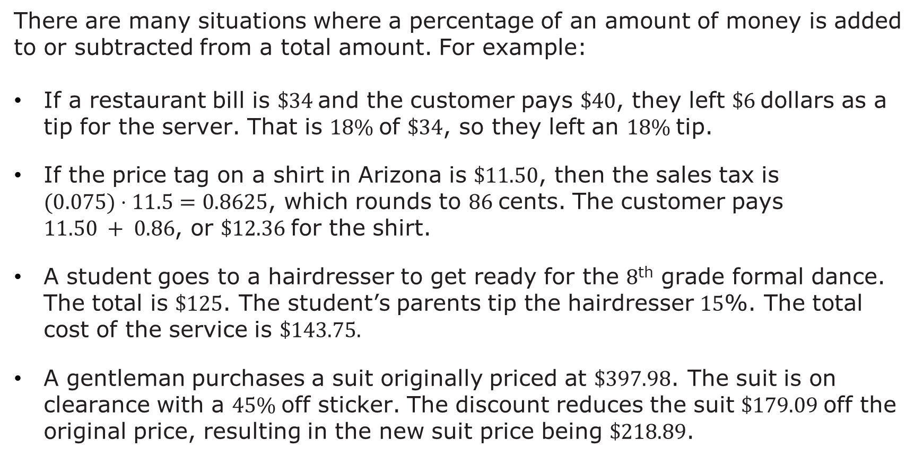
There are many situations where a percentage of an amount of money is added to or subtracted from a total amount. For example:
If a restaurant bill is $34 and the customer pays $40, they left $6 dollars as a tip for the server. That is 18% of $34, so they left an 18% tip.
If the price tag on a shirt in Arizona is $11.50, then the sales tax is $(0.075)⋅11.5=0.8625$, which rounds to 86 cents. The customer pays $11.50 + 0.86$, or $12.36 for the shirt.
A student goes to a hairdresser to get ready for the 8th grade formal dance. The total is $125. The student’s parents tip the hairdresser 15%. The total cost of the service is $143.75.
A gentleman purchases a suit originally priced at $397.98. The suit is on clearance with a 45% off sticker. The discount reduces the suit $179.09 off the original price, resulting in the new suit price being $218.89.
volume 1, pg. 323

Slide 21
 | Goes to | How It Works
Sales Tax | The government | Added to the price of the item
Gratuity (tip) | The person providing the service | Added to the cost of the service
Markup | The seller | Added to the cost of an item so the seller can make a profit
Markdown (discount) | The customer | Subtracted from the price of an item to encourage the customer to buy it
Commission | The salesperson | Percentage of the value of the sale that is subtracted from the total sale and given to the salesperson
volume 1, pg. 323

Slide 22

Guided Practice
volume 1, pg. 324

Slide 23

7.6.5 Guided Practice: Calculating Tax, Tip, and Fees
Johnny went shopping for his mom at Save More Foods and his subtotal was $11.75. The tax applied at the grocery store is 6%. How much was the tax for his purchase?
Rosa and her friends are eating at a restaurant for dinner. Their bill was $45.80. They want to leave a 20% tip. How much tip will the server receive?
Rick bought 3 shirts for $18 each, 2 pairs of socks for $3.99 a pair, and a pair of slacks for $45.00. The sales tax rate is 8.5%. How much sales tax did Rick pay?
volume 1, pg. 324

Slide 24

Your Turn
volume 1, pg. 324

Slide 25
7.6.6 Your Turn!
A city in Ohio has a sales tax rate of 7.25%. Complete the table to determine how much sales tax is for each item.
Item | Price Before Tax ($) | Sales Tax ($)
Pillow | 8.69
Blanket | 22.00
Trash Can | 14.50
volume 1, pg. 324

Slide 26
A store has a sale on pants. The original price of the pants is $19.00. With the discount, the price of one pair of pants before tax is $15.20. What was the percent discount?
A music store marks up its instruments. The store bought a guitar for $45 and sold it for $58.50. The store bought a trumpet for $80 and sold it for $104. What is the percent markup the store used to price the guitar and trumpet?
volume 1, pg. 324

Slide 27

Wrap-Up
volume 1, pg. 325

Slide 28
7.6.7 Wrap-Up: Ticket Out the Door
Mrs. Jones attended a Southern Living home party. She purchased a vase that cost $34.99 plus $3.00 for shipping. There is a 8.25% sales tax on the cost of the vase and shipping charge. What is the amount of tax Mrs. Jones paid on her purchase?
volume 1, pg. 325

